Slide 1
Anatomy of NN

Slide 2
Outline
Anatomy of a NN
Design choices
Activation function
Loss function
Output units
Architecture

Slide 3
Outline
Anatomy of a NN
Design choices
Activation function
Loss function
Output units
Architecture

Slide 4
Anatomy of artificial neural network (ANN)
neuron
node
input
output
X
Y

Slide 5
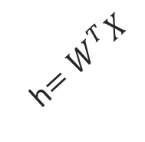
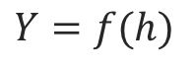
Anatomy of artificial neural network (ANN)
neuron
node
input
output
Affine transformation
$$Y=f(h)$$
Activation
X
Y
h$=W^{T}X$
We will talk later about the choice of activation function. So far we have only talked about sigmoid as an activation function but there are other choices.

Slide 6

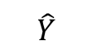
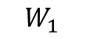
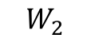
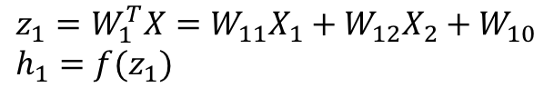
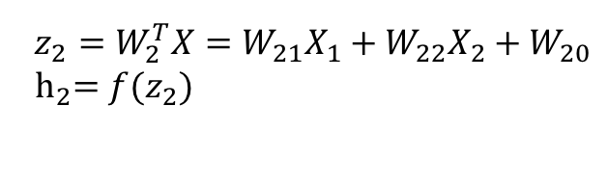
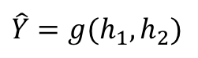
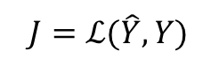
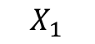
Anatomy of artificial neural network (ANN)
Input layer
hidden layer
output layer
$$z_{1}=W_{1}^{T}X=W_{11}X_{1}+W_{12}X_{2}+W_{10} \\ h_{1}=f(z_{1})$$
$$X_{1}$$
$$W_{1}$$
$$\hat{Y}$$
$$\hat{Y}=g(h_{1},h_{2})$$
$$J=ℒ(\hat{Y},Y)$$
Output function
Loss function
$$X_{2}$$
$$W_{2}$$
$$z_{2}=W_{2}^{T}X=W_{21}X_{1}+W_{22}X_{2}+W_{20}$$
$${ h}_{2}=f(z_{2})$$
We will talk later about the choice of the output layer and the loss function. So far we consider sigmoid as the output and log-bernouli.

Slide 7
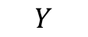
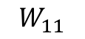
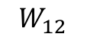
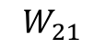
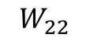
Anatomy of artificial neural network (ANN)
Input layer
hidden layer 1
hidden layer 2
output layer
$$X_{1}$$
$$W_{11}$$
$$W_{21}$$
$$Y$$
$$X_{2}$$
$$W_{12}$$
$$W_{22}$$

Slide 8
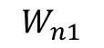
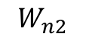
Anatomy of artificial neural network (ANN)
Input layer
hidden layer 1
hidden layer n
output layer
$$X_{1}$$
$$W_{11}$$
…
$$W_{n1}$$
$$Y$$
$$X_{2}$$
$$W_{12}$$
…
$$W_{n2}$$
We will talk later about the choice of the number of layers.

Slide 9
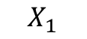
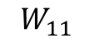
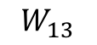
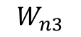
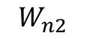
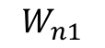
Anatomy of artificial neural network (ANN)
Input layer
hidden layer 1, 3 nodes
hidden layer n
3 nodes
output layer
$$W_{n1}$$
$$W_{11}$$
$$X_{1}$$
$$W_{12}$$
…
$$W_{n2}$$
$$Y$$
$$X_{2}$$
$$W_{13}$$
$$W_{n3}$$

Slide 10
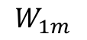
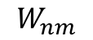
Anatomy of artificial neural network (ANN)
Input layer
hidden layer 1,
hidden layer n
output layer
m nodes
$$W_{n1}$$
$$W_{11}$$
$$X_{1}$$
m nodes
…
…
$$Y$$
$$X_{2}$$
$$W_{1m}$$
$$W_{nm}$$
We will talk later about the choice of the number of nodes.

Slide 11
Anatomy of artificial neural network (ANN)
Input layer
hidden layer 1,
hidden layer n
output layer
m nodes
$$W_{n1}$$
$$W_{11}$$
$$X_{1}$$
m nodes
Number of inputs d
…
…
$$Y$$
$$X_{2}$$
$$W_{1m}$$
$$W_{nm}$$
Number of inputs is specified by the data

Slide 12
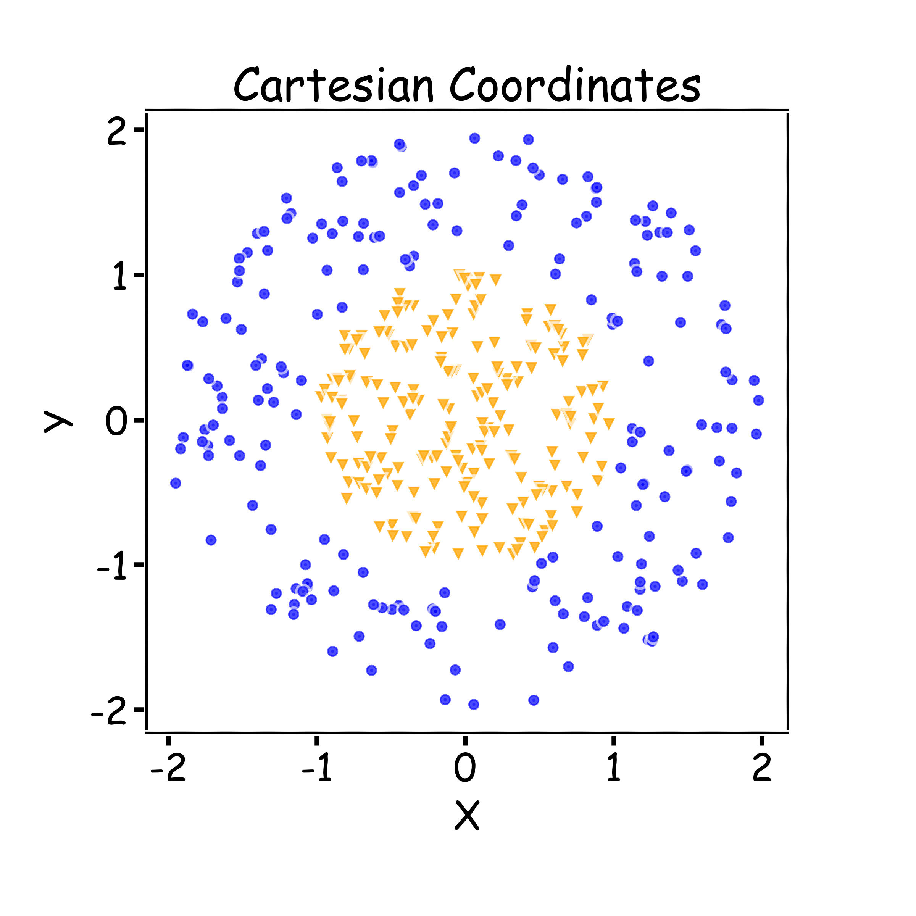
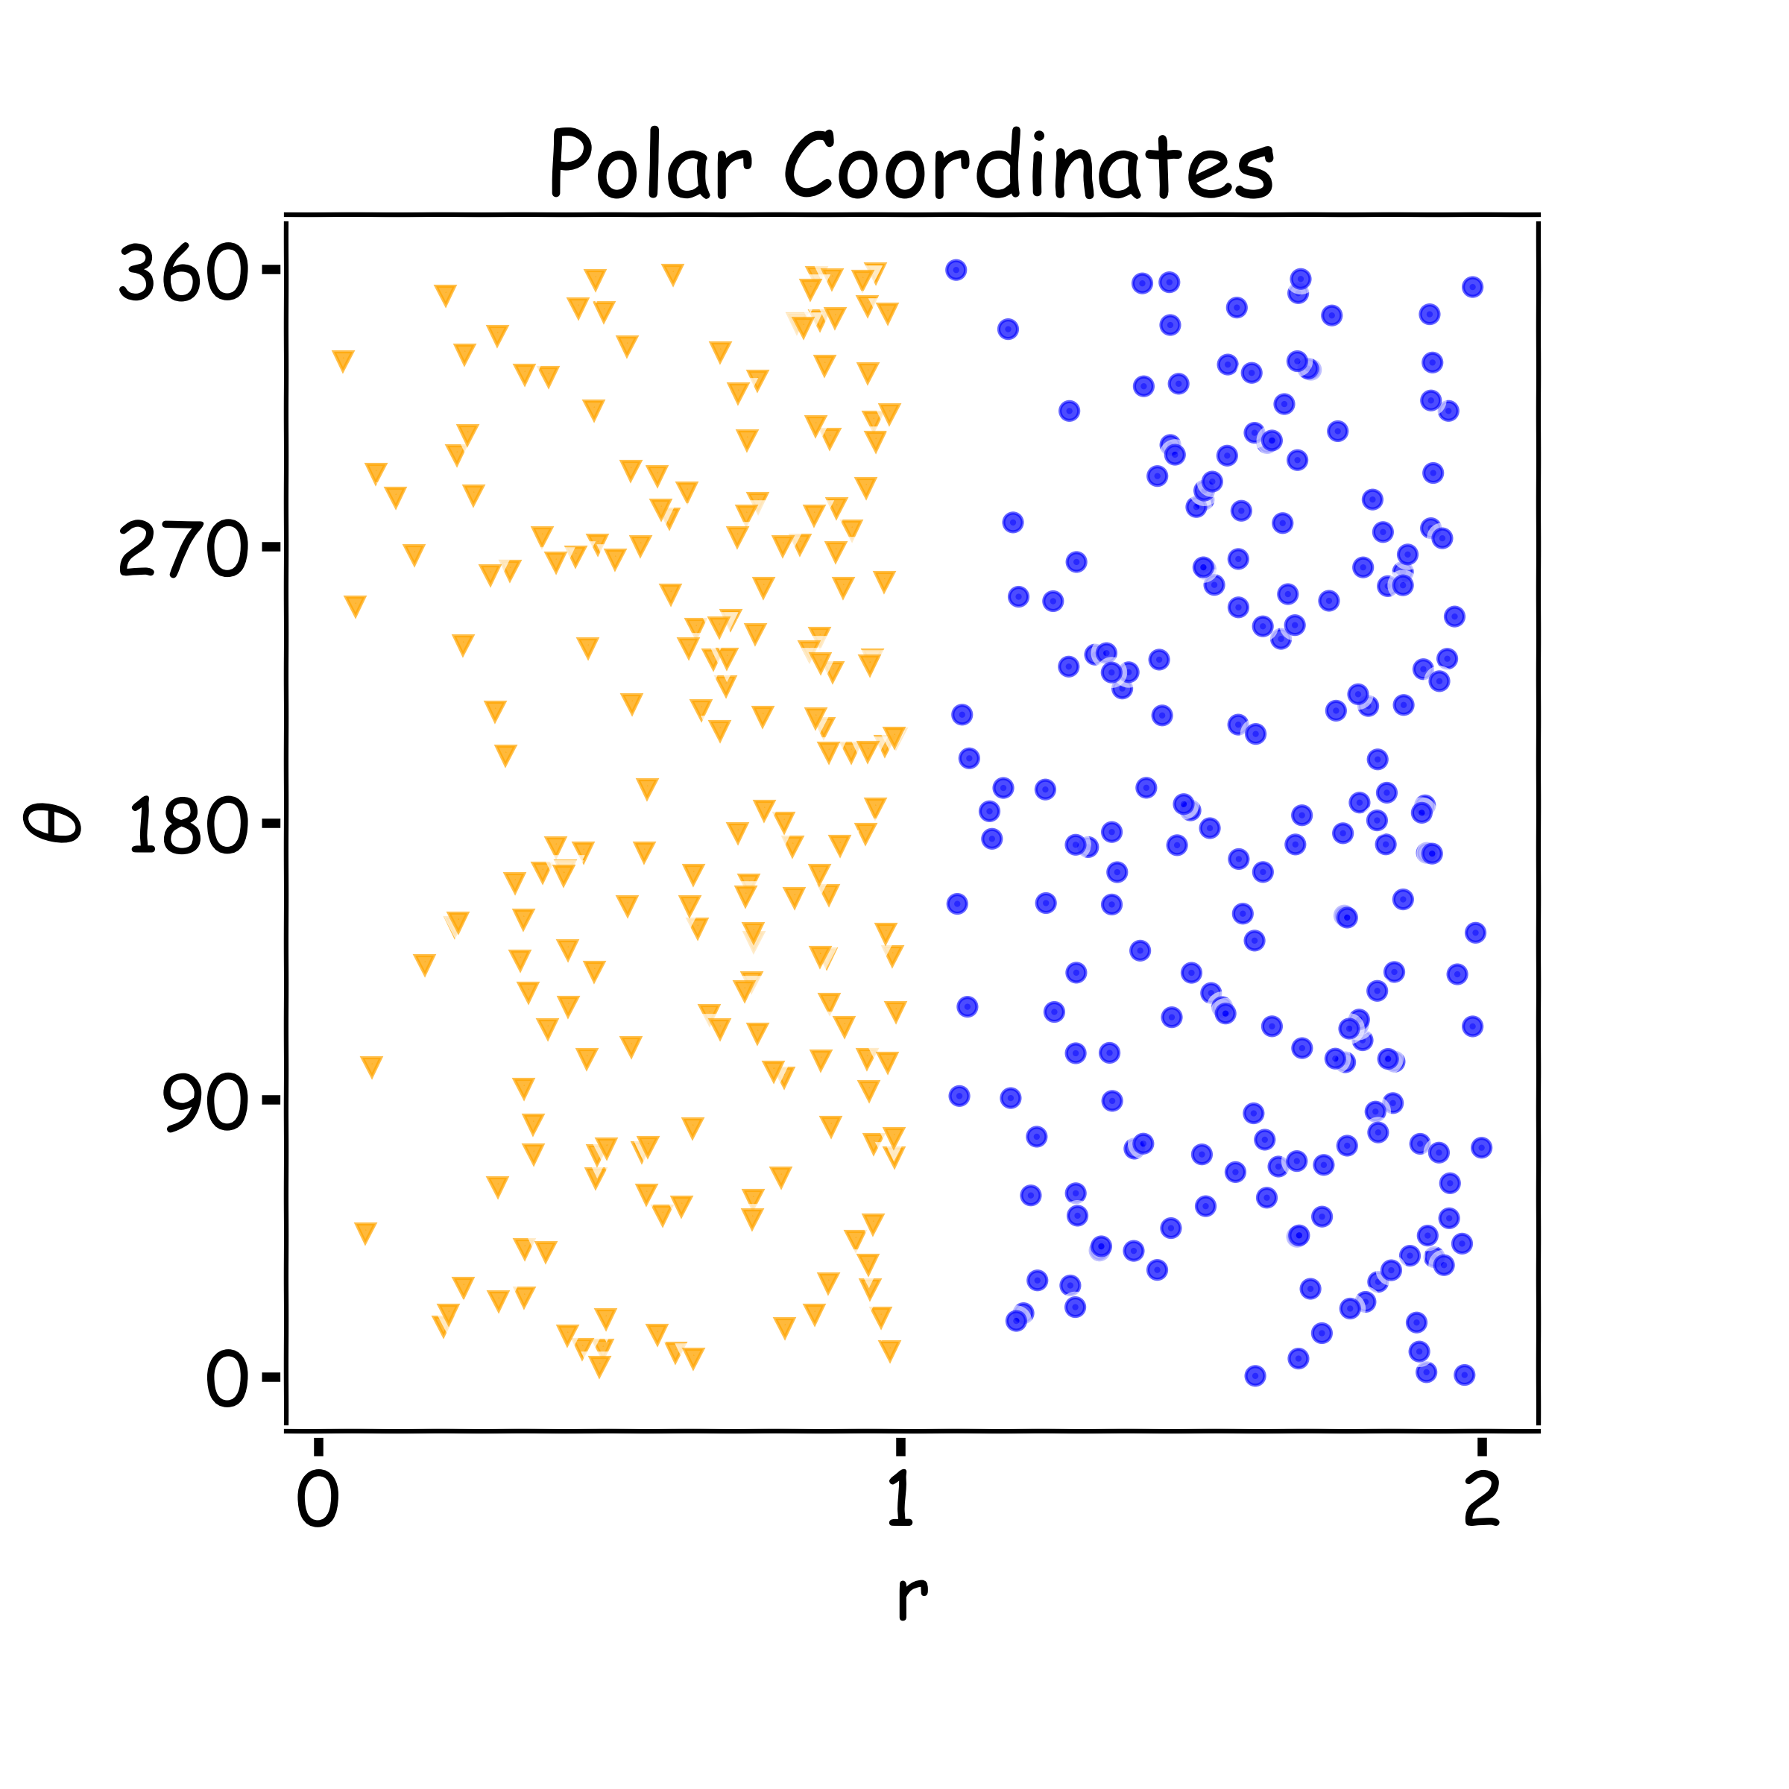
Why layers? Representation
Representation matters!

Slide 13
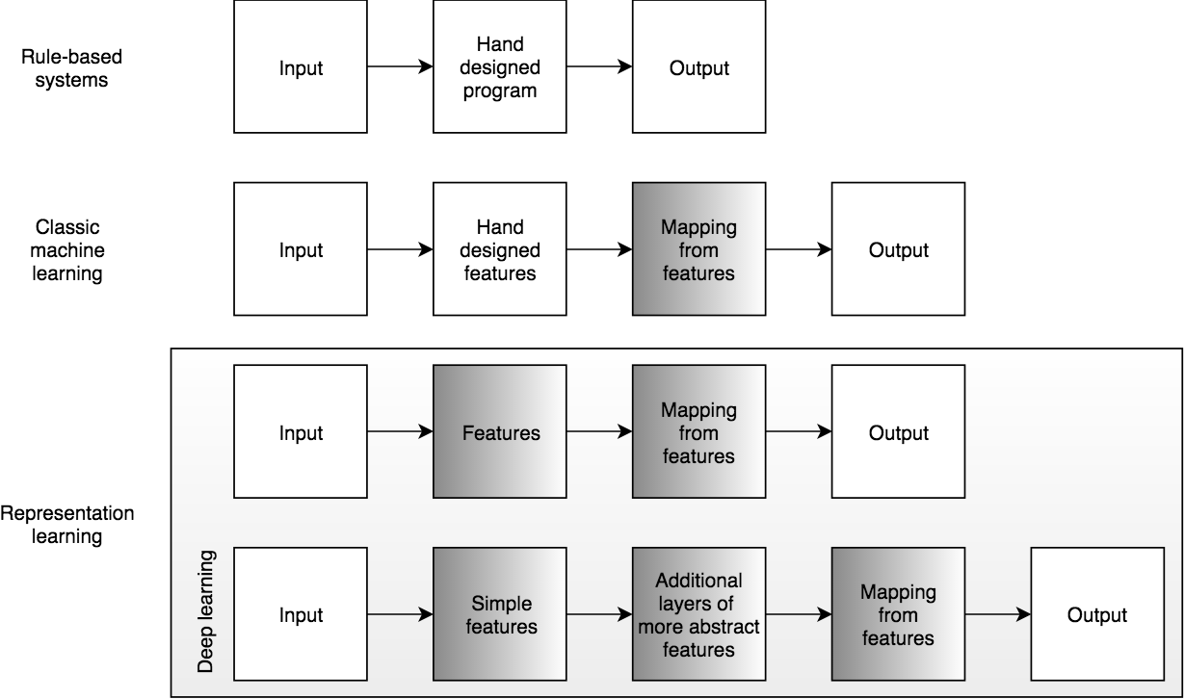
Learning Multiple Components

Slide 14
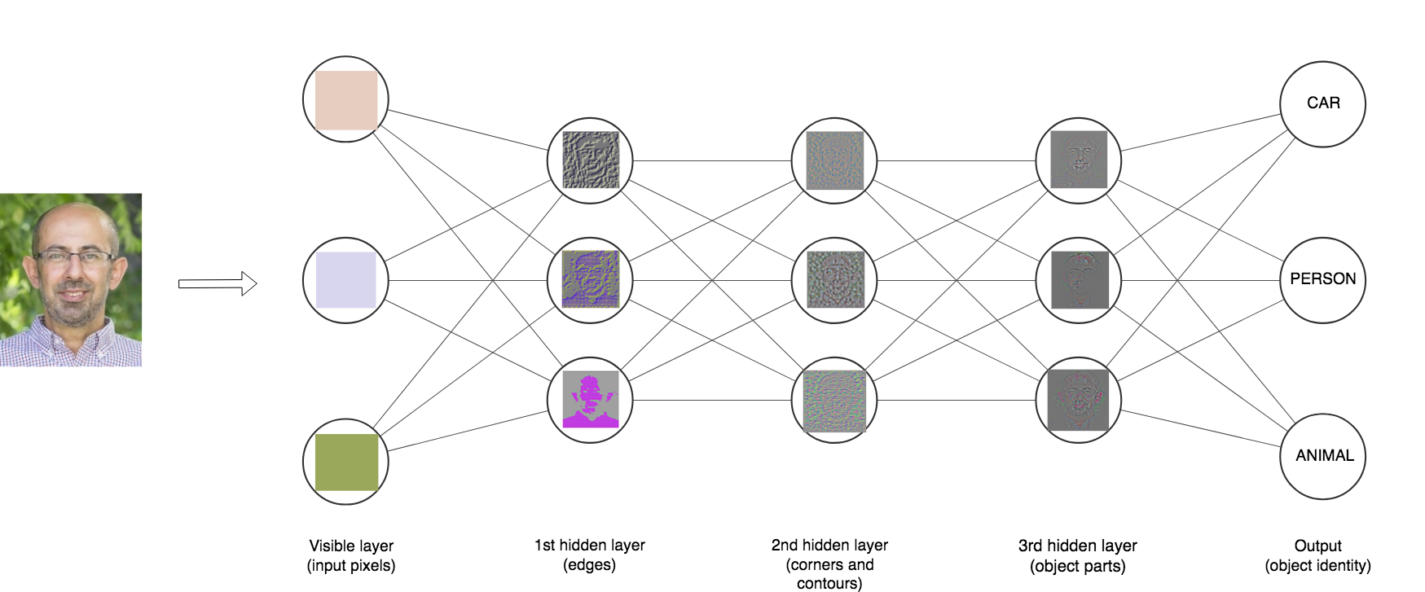

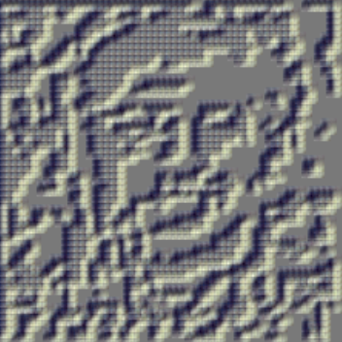
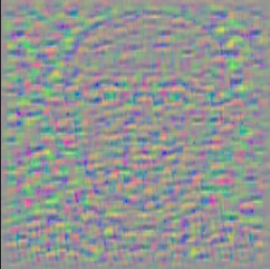


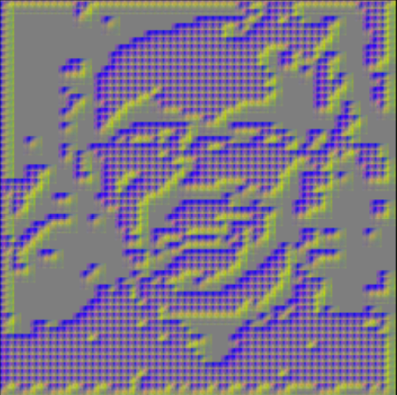
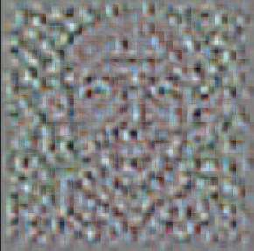
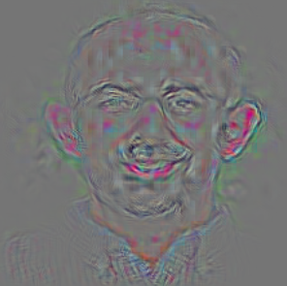
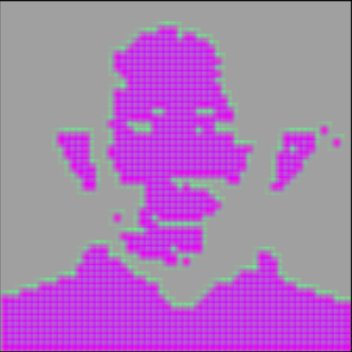
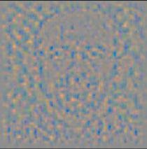


Depth = Repeated Compositions

Slide 15
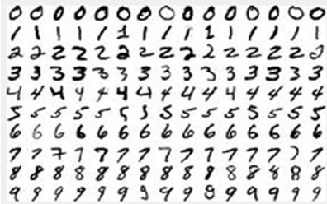
Neural Networks
Hand-written digit recognition: MNIST data

Slide 16
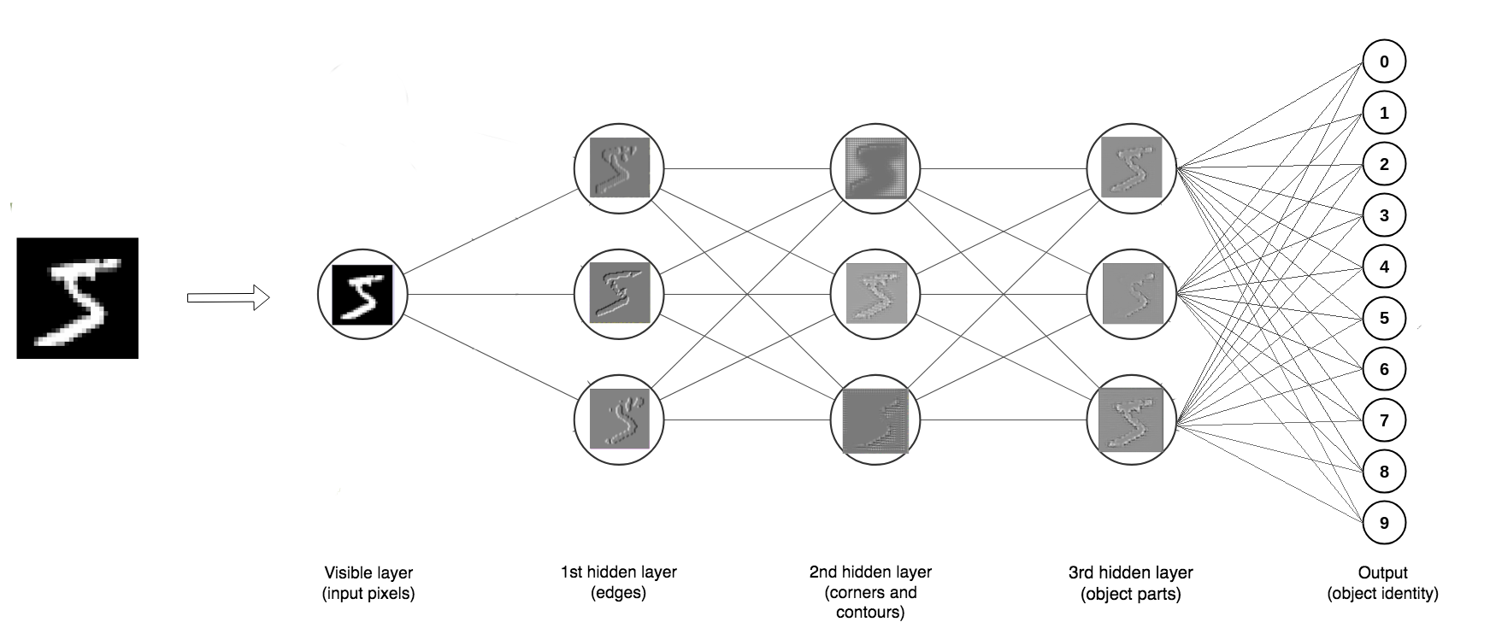
Depth = Repeated Compositions

Slide 17
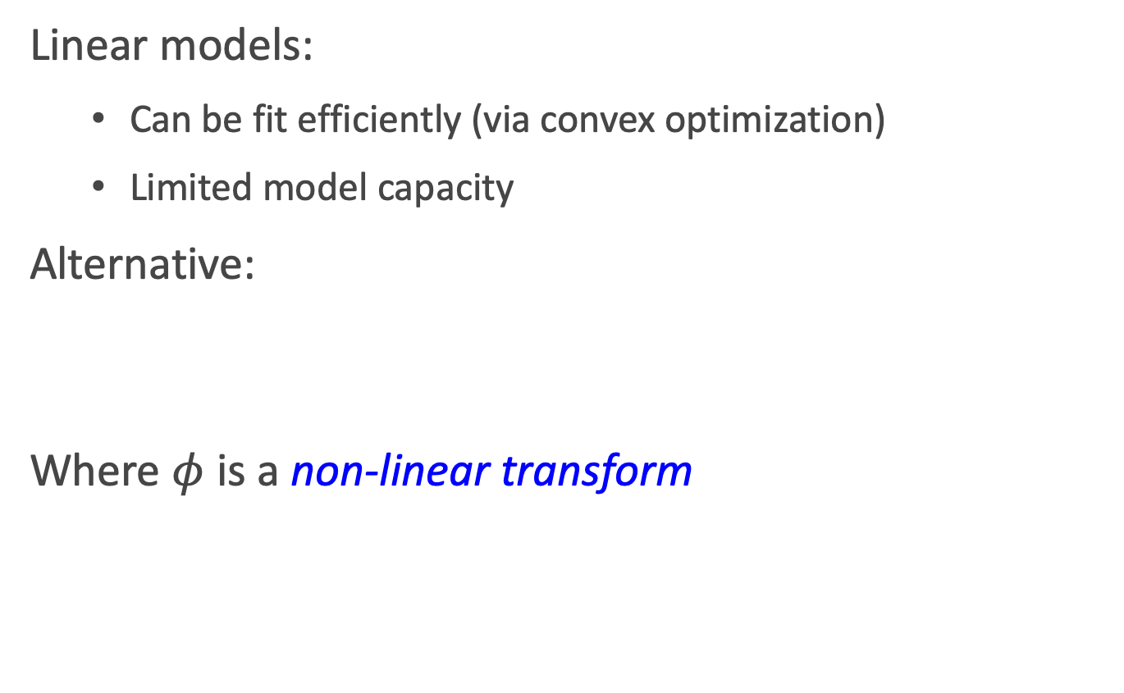
Beyond Linear Models
Linear models:
Can be fit efficiently (via convex optimization)
Limited model capacity
Alternative:
Where $φ$ is a non-linear transform

Slide 18
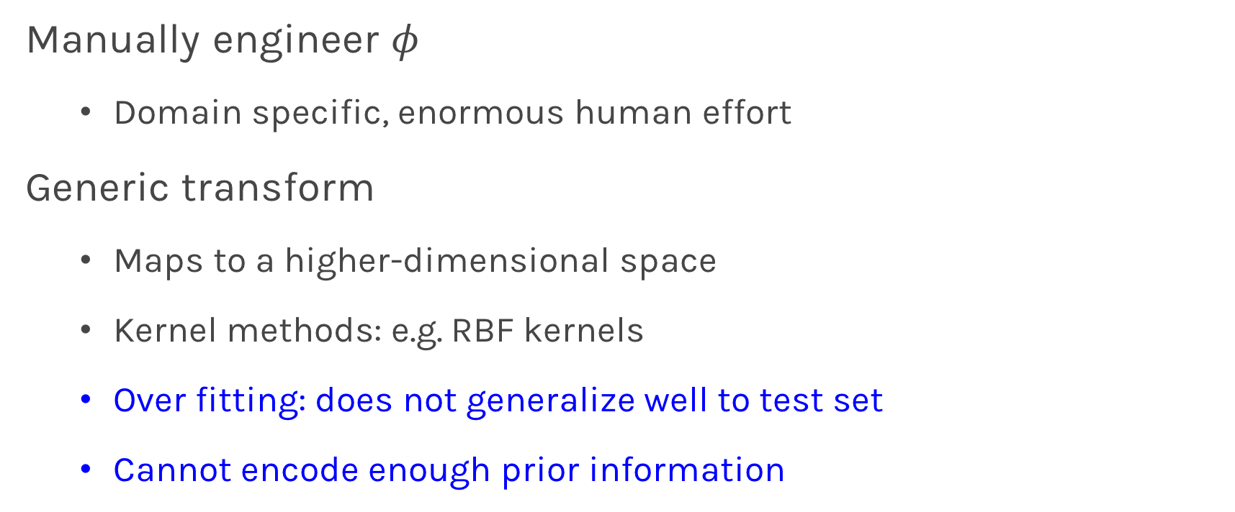
Traditional ML
Manually engineer $φ$
Domain specific, enormous human effort
Generic transform
Maps to a higher-dimensional space
Kernel methods: e.g. RBF kernels
Over fitting: does not generalize well to test set
Cannot encode enough prior information

Slide 19

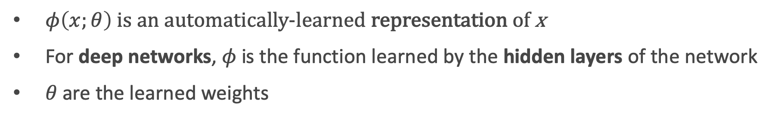
Deep Learning
Directly learn $φ$
$$f\left(x;θ\right)=W^{T}φ(x;θ)$$
$φ\left(x;θ\right)$ is an automatically-learned representation of x
For deep networks, $φ$is the function learned by the hidden layers of the network
$θ$ are the learned weights
Non-convex optimization
Can encode prior beliefs, generalizes well

Slide 20
Outline
Anatomy of a NN
Design choices
Activation function
Loss function
Output units
Architecture

Slide 21
Outline
Anatomy of a NN
Design choices
Activation function
Loss function
Output units
Architecture

Slide 22
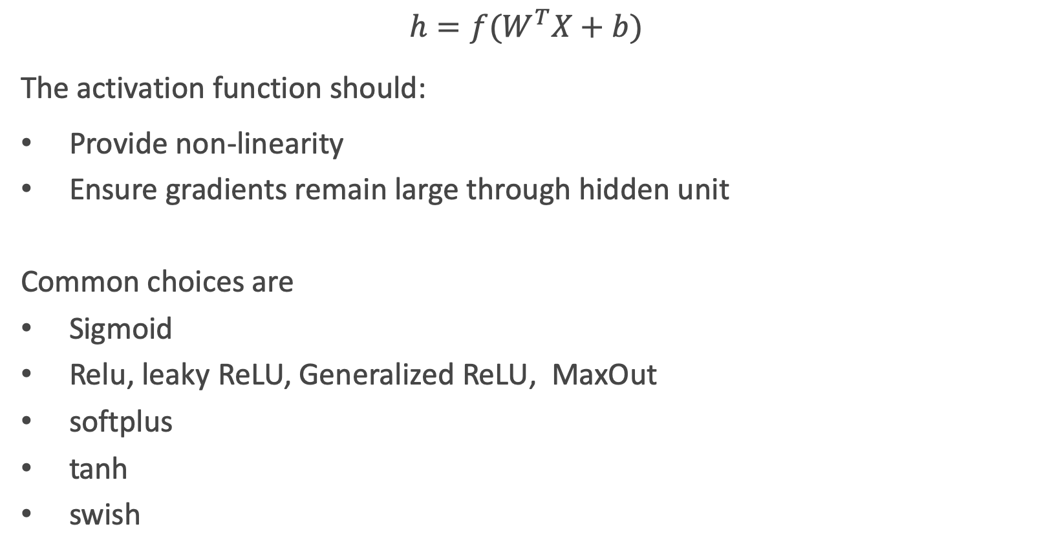
Activation function
$$h=f(W^{T}X+b)$$
The activation function should:
Provide non-linearity
Ensure gradients remain large through hidden unit
Common choices are
Sigmoid
Relu, leaky ReLU, Generalized ReLU, MaxOut
softplus
tanh
swish

Slide 23
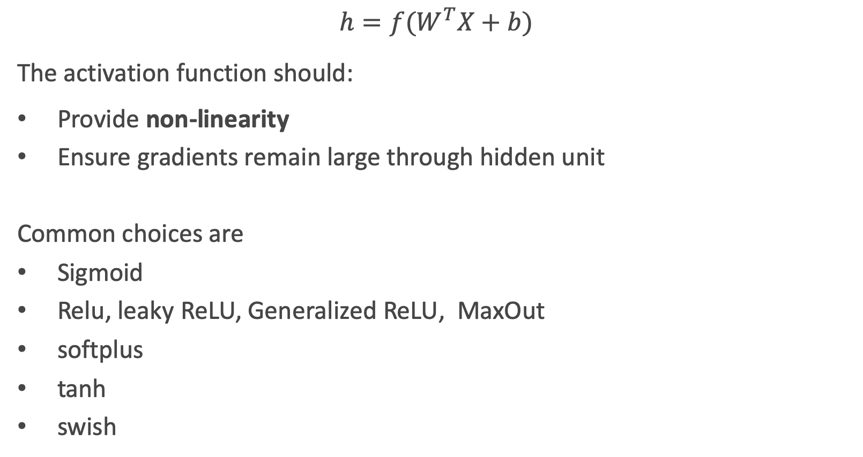
Activation function
$$h=f(W^{T}X+b)$$
The activation function should:
Provide non-linearity
Ensure gradients remain large through hidden unit
Common choices are
Sigmoid
Relu, leaky ReLU, Generalized ReLU, MaxOut
softplus
tanh
swish

Slide 24
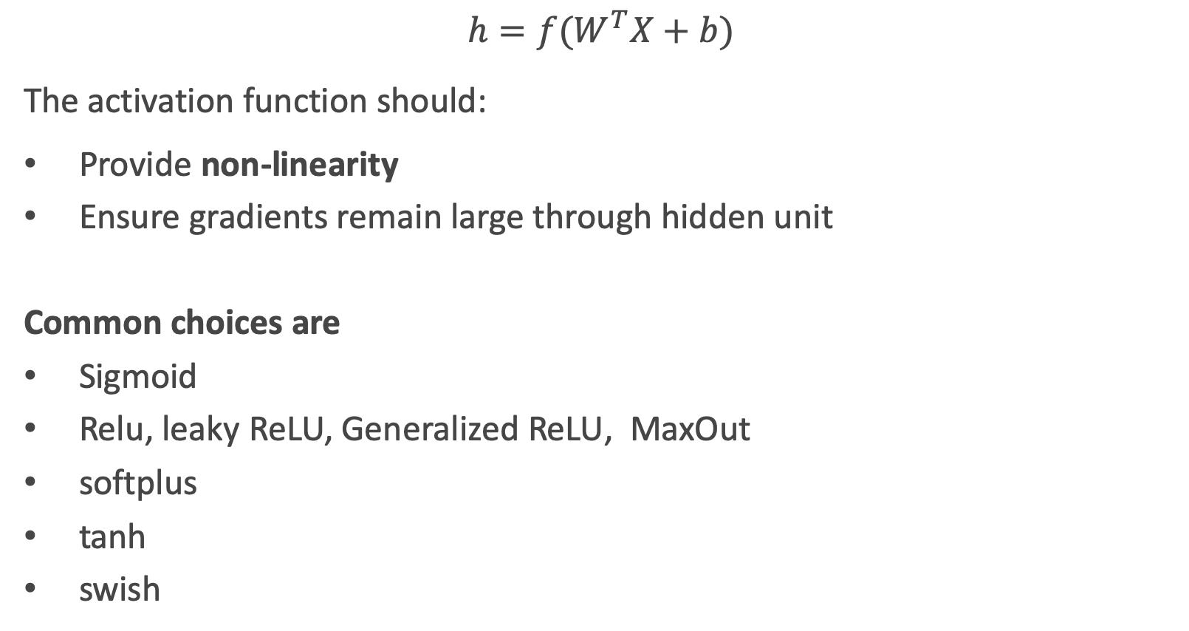
Activation function
$$h=f(W^{T}X+b)$$
The activation function should:
Provide non-linearity
Ensure gradients remain large through hidden unit
Common choices are
Sigmoid
Relu, leaky ReLU, Generalized ReLU, MaxOut
softplus
tanh
swish

Slide 25
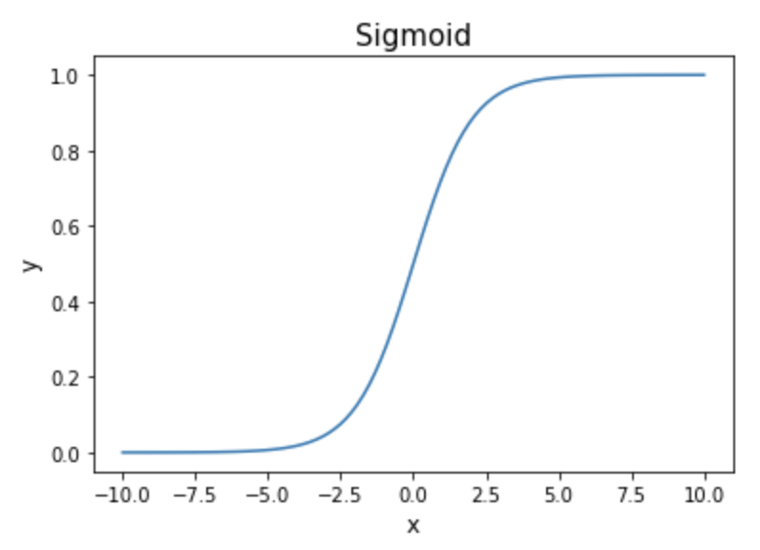
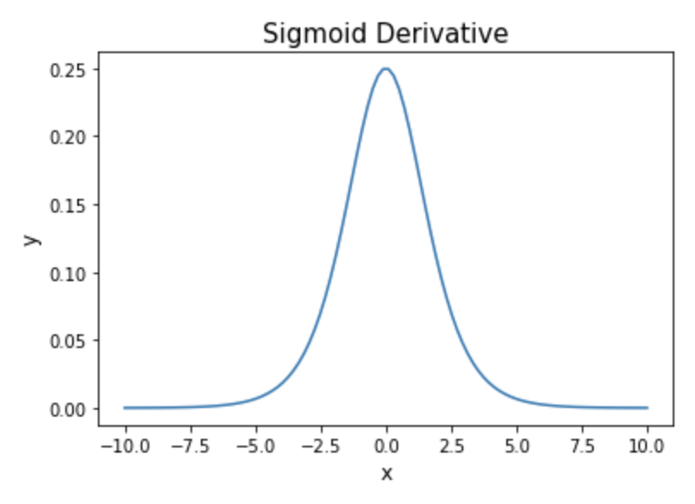
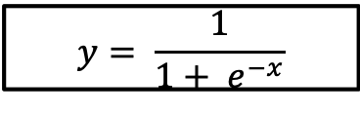
Sigmoid (aka Logistic)
$$y= \frac{1}{1+ e^{−x}}$$
Derivative is zero for much of the domain. This leads to “vanishing gradients” in backpropagation.

Slide 26
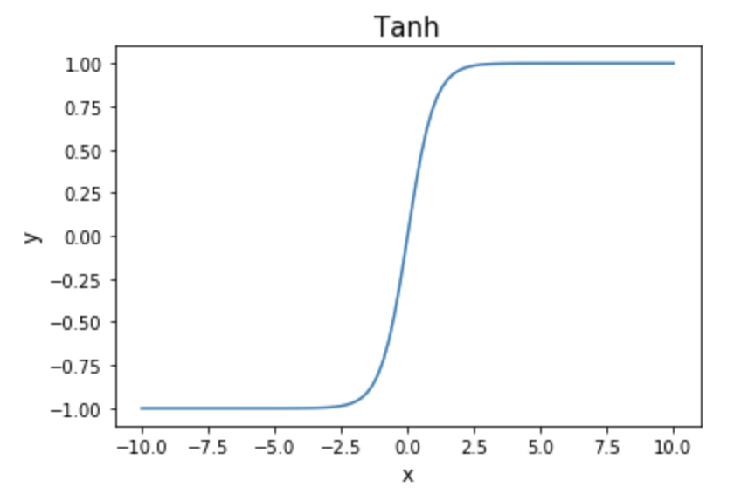
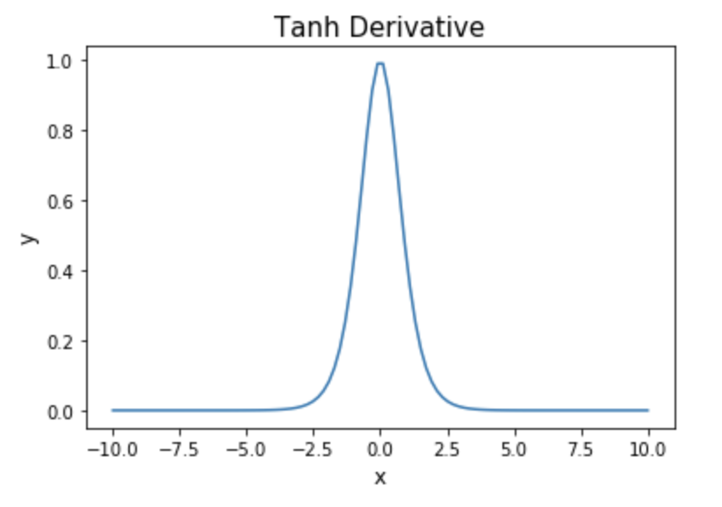
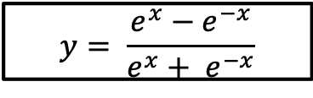
Hyperbolic Tangent (Tanh)
$$y= \frac{e^{x}−e^{−x}}{e^{x}+ e^{−x}}$$
Same problem of “vanishing gradients” as sigmoid.

Slide 27



Rectified Linear Unit (ReLU)
$$y=max⁡(0, x)$$
Two major advantages:
No vanishing gradient when x > 0
Provides sparsity (regularization) since y = 0 when x < 0

Slide 28



Leaky ReLU
$$y=\max\left(0, x\right)+α∗min⁡(0, x)$$
Where $α$ is a small constant (negative slope)
Tries to fix “dying ReLU” problem: derivative is non-zero everywhere.
Some people report success with this form of activation function, but the results are not always consistent

Slide 29


Generalized ReLU
Generalization: For $α_{i}>0$
$$g\left(x_{i}, α\right)=\max\left\{a,x_{i}\right\}+α\min{\{0,x_{i}\}}$$

Slide 30


Maxout
Max of k linear functions. Directly learn the activation function.
$$g(x)= \max_{i∈\{1,…,k\}}{α_{i}x_{i}+β}$$

Slide 31



Swish: A Self-Gated Activation Function
Currently, the most successful and widely-used activation function is the ReLU. Swish tends to work better than ReLU on deeper models across a number of challenging datasets.
$$g\left(x\right)=x σ(x)$$

Slide 32
Outline
Anatomy of a NN
Design choices
Activation function
Loss function
Output units
Architecture

Slide 33

Loss Function
Cross-entropy between training data and model distribution (i.e. negative log-likelihood)
$J\left(W\right)=−𝔼_{x,y\sim {\hat{p}}_{data}}\log{p_{model}}$(y|x)
Do not need to design separate loss functions.
Gradient of cost function must be large enough

Slide 34



Loss Function
Example: sigmoid output + squared loss
$$L_{sq}={\left(y−\hat{y}\right)}^{2}={\left(y−σ\left(x\right)\right)}^{2}$$
Flat surfaces

Slide 35



Cost Function
Saturates only when the model makes correct predictions
Example: sigmoid output + cross-entropy loss
$$L_{ce}\left(y,\hat{y}\right)=−\{ y\log{\hat{y}+\left(1−y\right)\log{(1−\hat{y})\}}}$$

Slide 36
Design Choices
Activation function
Loss function
Output units
Architecture
Optimizer

Slide 37
Output Units
Output Type | Output Distribution | Output layer | Cost Function
Binary

Slide 38





Link function
$$X⟹φ\left(X\right)=W^{T}X⟹P\left(y=0\right)=\frac{1}{1+e^{φ(X)}}$$
X
$$\hat{Y}=P(y=0)$$
OUTPUT UNIT
X
$$φ\left(X\right)$$
$$σ(φ)$$
$$\hat{Y}=P(y=0)$$

Slide 39
Output Units
Output Type | Output Distribution | Output layer | Cost Function
Binary | Bernoulli | Sigmoid | Binary Cross Entropy

Slide 40
Output Units
Output Type | Output Distribution | Output layer | Cost Function
Binary | Bernoulli | Sigmoid | Binary Cross Entropy
Discrete

Slide 41




Link function multi-class problem
X
$$\hat{Y}$$
OUTPUT UNIT
$$\hat{Y}=\frac{e^{φ_{k}\left(X\right)}}{\sum_{k=1}^{K}{e^{φ_{k}\left(X\right)}}}$$
X
$$\vec{φ}(X)$$
$$SoftMax$$

Slide 42
Output Units
Output Type | Output Distribution | Output layer | Cost Function
Binary | Bernoulli | Sigmoid | Binary Cross Entropy
Discrete | Multinoulli | Softmax | Cross Entropy

Slide 43
Output Units
Output Type | Output Distribution | Output layer | Cost Function
Binary | Bernoulli | Sigmoid | Binary Cross Entropy
Discrete | Multinoulli | Softmax | Cross Entropy
Continuous | Gaussian | Linear | MSE

Slide 44
Output Units
Output Type | Output Distribution | Output layer | Cost Function
Binary | Bernoulli | Sigmoid | Binary Cross Entropy
Discrete | Multinoulli | Softmax | Cross Entropy
Continuous | Gaussian | Linear | MSE
Continuous | Arbitrary | - | GANS

Slide 45
Design Choices
Activation function
Loss function
Output units
Architecture
Optimizer

Slide 46


NN in action

Slide 47


NN in action

Slide 48


NN in action

Slide 49

NN in action
…

Slide 50


NN in action

Slide 51


NN in action

Slide 52


NN in action

Slide 53






Universal Approximation Theorem
Think of a Neural Network as function approximation.
$$Y=f\left(x\right)+ε$$
$$Y=\hat{f}(x)+ε$$
NN: $⟹\hat{f}(x)$
One hidden layer is enough to represent an approximation of any function to an arbitrary degree of accuracy
So why deeper?
Shallow net may need (exponentially) more width
Shallow net may overfit more
$$W_{3}$$
$$\hat{Y}$$
$$W_{2}$$
$$W_{4}$$
depth
$$W_{1}$$
width

Slide 54

Better Generalization with Depth
(Goodfellow 2017)

Slide 55

Shallow Nets Overfit More
Depth helps, and it’s not just because of more parameters
Don’t worry about this word “convolutional”. It’s just a special type of neural network, often used for images.
(Goodfellow 2017)
The 11-layer net generalizes better on the test set when controlling for number of parameters.
The 3-layer nets perform worse on the test set, even with similar number of total parameters.

